Slide 1
The Effects of Bare Ground Non-Chloride Potassium Acetate Liquid De-Icer on Water Quality of the Raritan River
By: Dua Ali, Andy Zhao, Kaleb Zhao, Philip Wyka: Section 12, Team 6, Fall 2025

Slide 2
Introduction
A growing environmental concern is the use of de-icers on roads which can cause harm to the ecosystems.
  Sodium chloride is thought to melt ice which can actually cause the soil to infiltrate into the water increasing the concentrations of ions in the water and raise the salinity.
    Corrosion: High chloride levels can damage pipes, cars, bridges, etc.
    Eutrophication: Organic de-icers like potassium acetate can add nutrients which cause algae and lower DO

Slide 3
Hypothesis

Slide 4
Materials

Slide 5
Methods

Slide 6
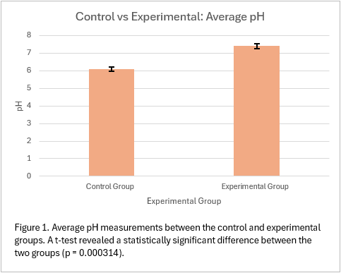
Results: pH

Slide 7
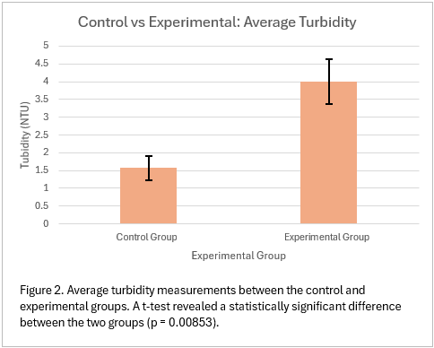
Results: Turbidity

Slide 8
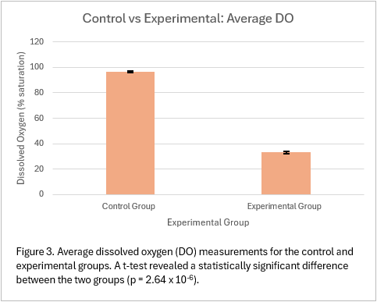
Results: DO

Slide 9
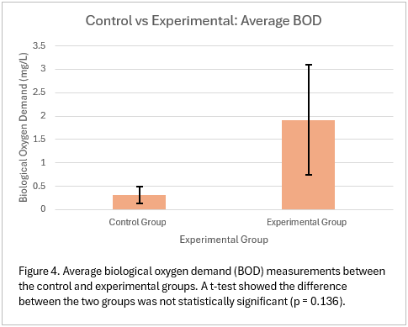
Results: BOD

Slide 10
Results: Summary

Slide 11
Discussion

Slide 12
Discussion (cont.)

Slide 13
Questions?

